Slide 1


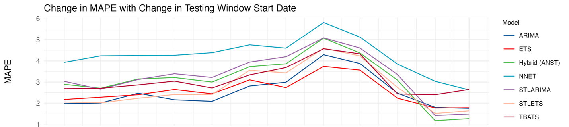
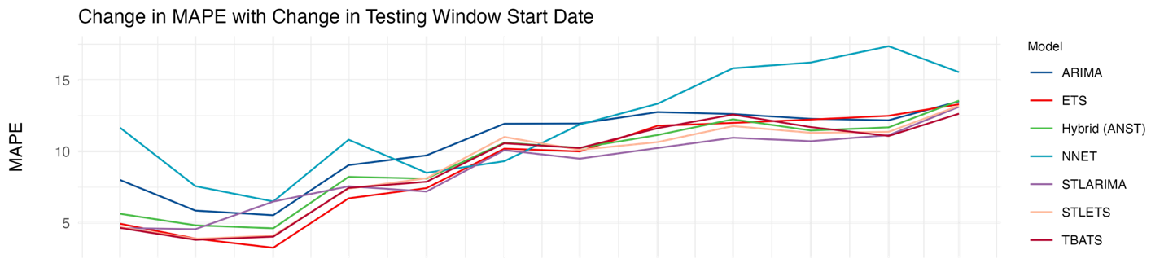

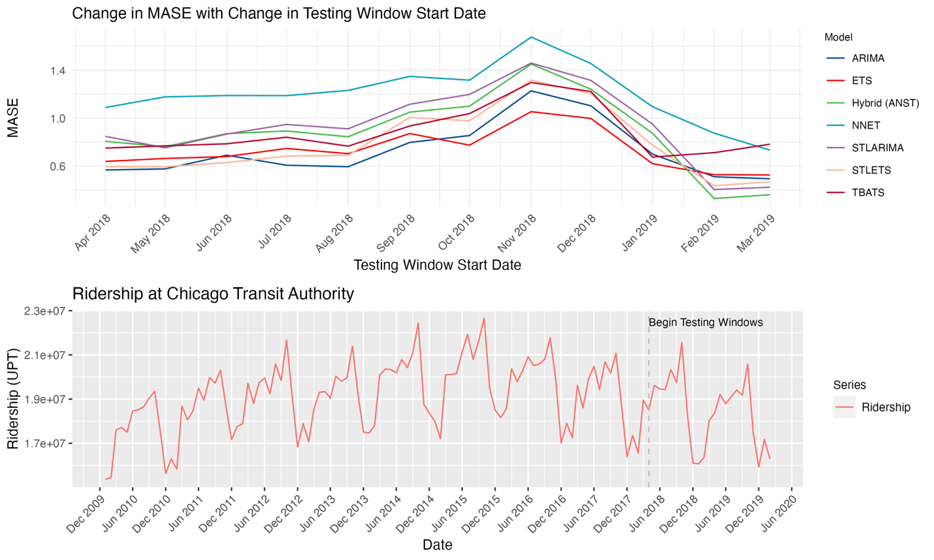
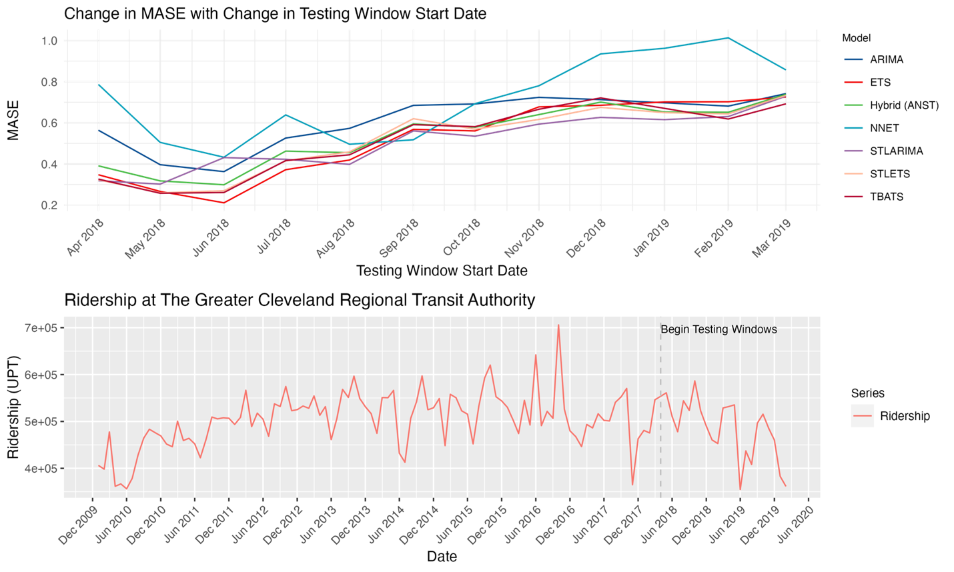
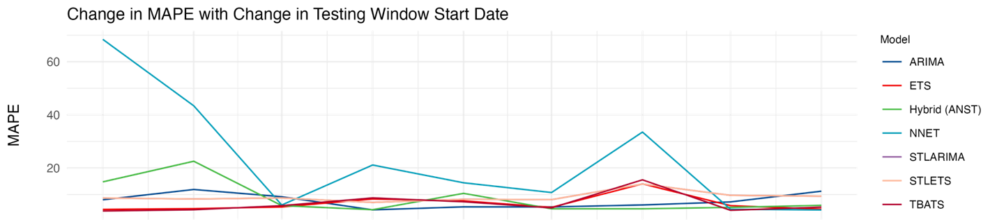
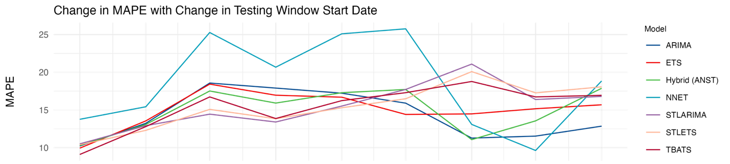
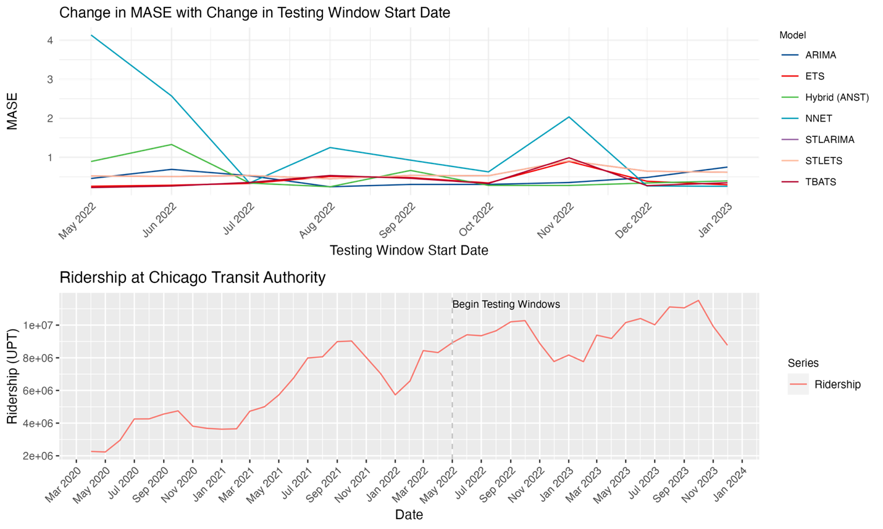
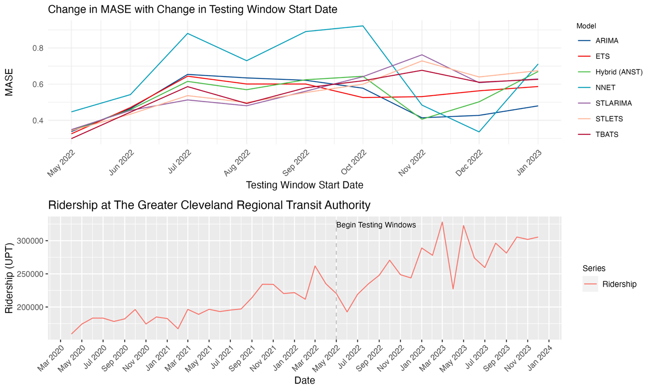
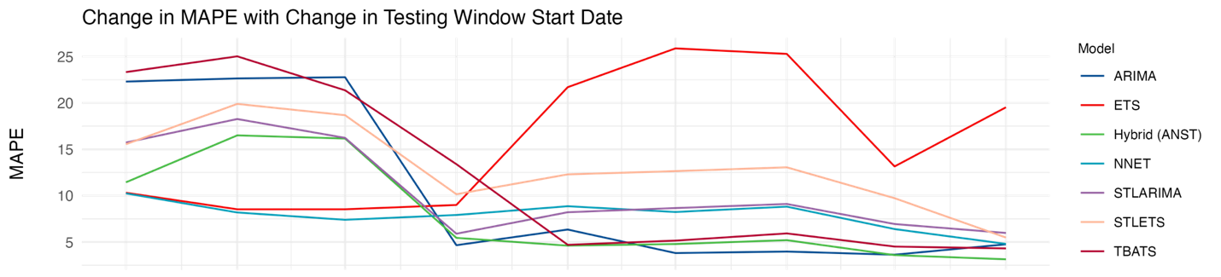
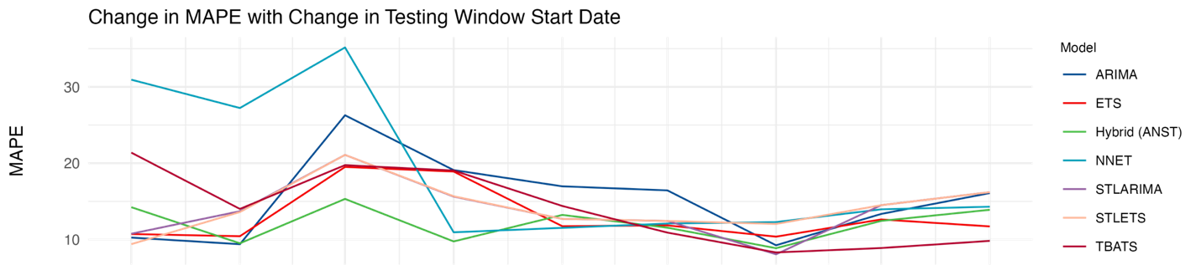
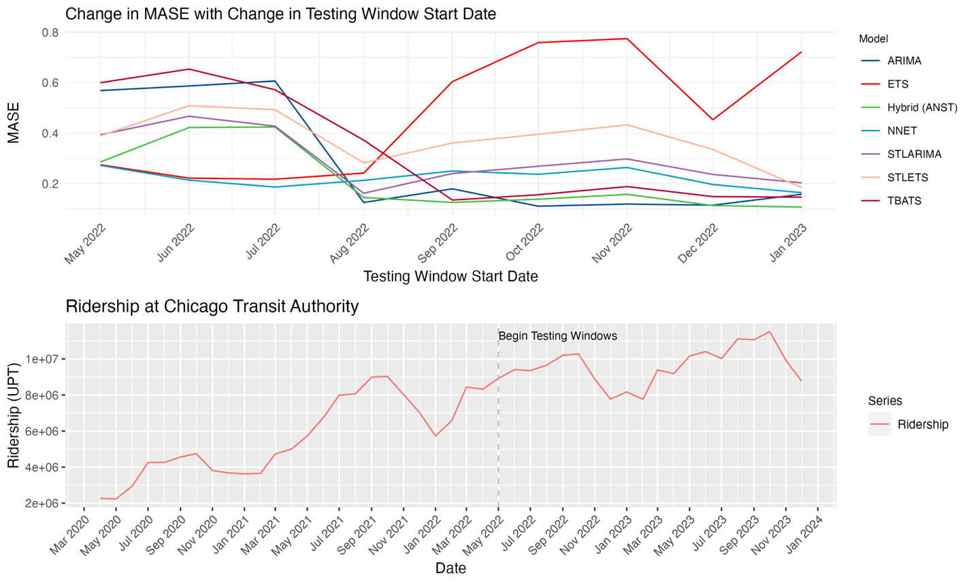
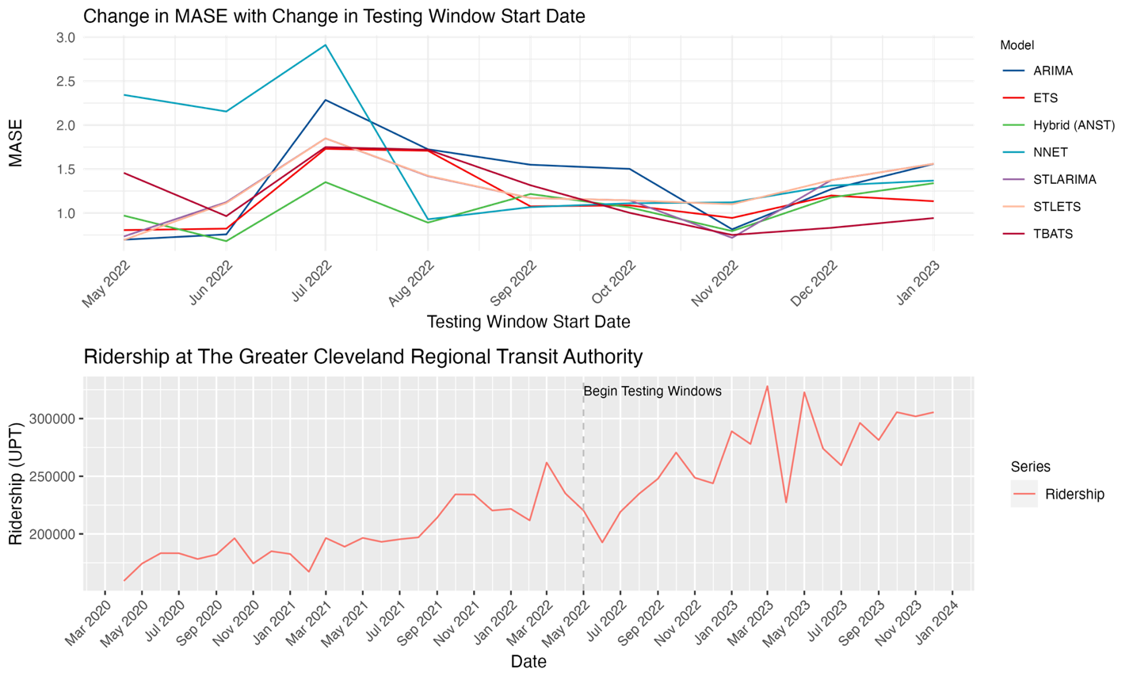
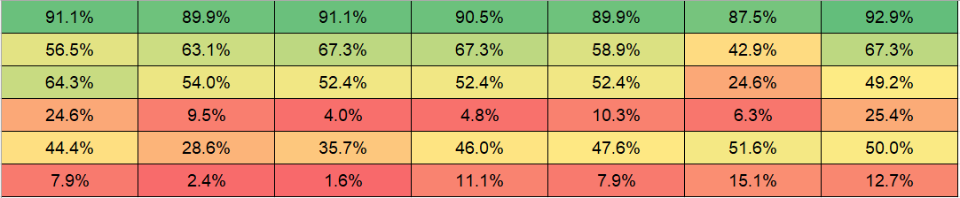
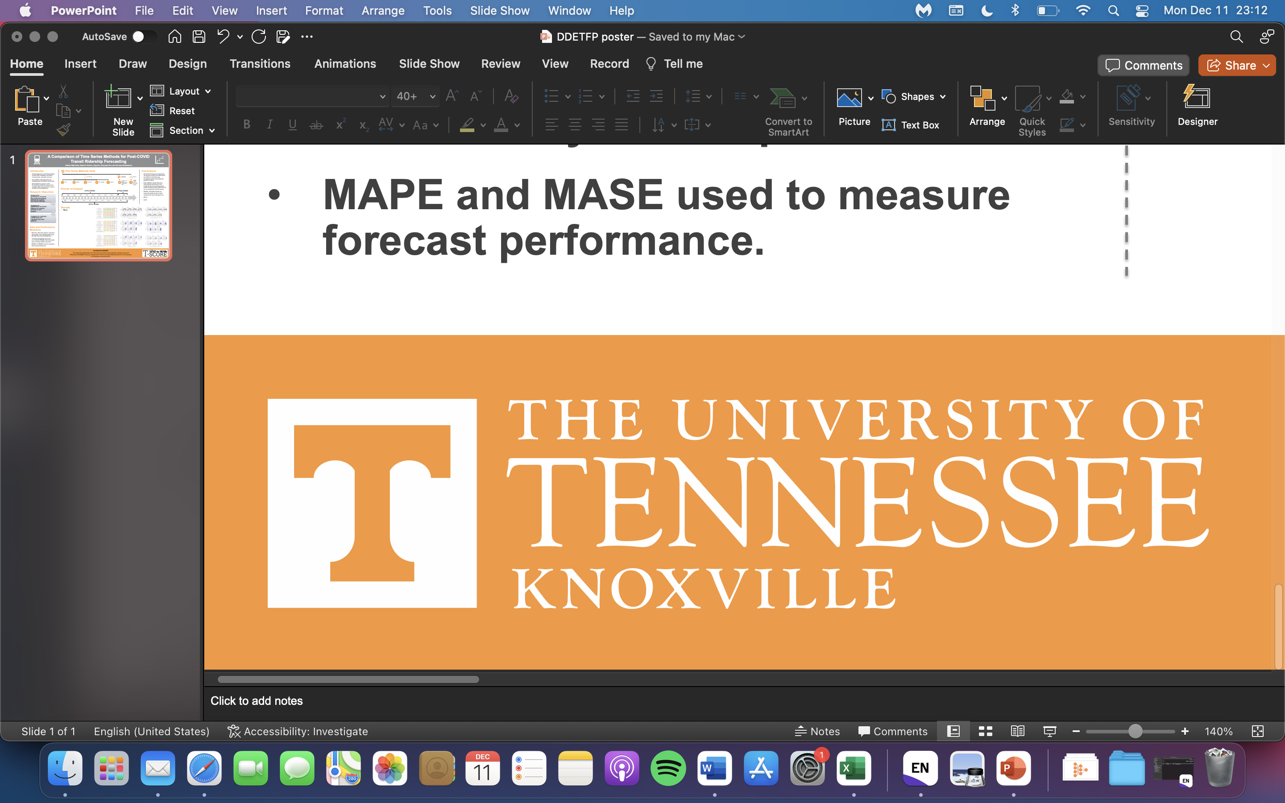
Strategies for Heavy Rail Ridership Forecasting
Using Statistical, Machine Learning, and
Ensemble Time Series Methods
Ashley Hightower, Kittelson & Associates
ahightower@kittelson.com
Dr. Candace Brakewood, University of Tennessee Knoxville
cbrakewood@utk.edu
Classical
ARIMA
STL-ARIMA
Machine Learning
Feed-forward autoregressive neural network with a single hidden layer
ETS
STL-ETS
TBATS
Ensemble
ARIMA, neural network, STL-ARIMA, and TBATS
Time Series Methods Used
Introduction
Transit agencies need forecasting to plan their budgets, prioritize investments, and plan service.
The most commonly-used forecasting methods tend to be time-consuming to set up and require extensive calibration.
Time series methods are relatively cheap and simple but are not commonly used in practice in the transit industry.
ARIMA - autoregressive integrated moving average
ETS - exponential smoothing
STL - seasonal and trend decomposition using locally estimated scatterplot smoothing
TBATS - exponential smoothing state space model with trigonometric seasonality,
Box-Cox transform, autoregressive moving average errors, trend, and seasonal periods
Example of Results for Two of Fourteen Agencies
Pre-COVID Forecasts
Chicago: almost all forecasts have a MAPE < 5%. Most have MASE < 1.00, except when using the Nov/Dec window
Cleveland: Most forecasts have MAPE < 10% until the Sep window. Almost all forecasts have MASE
< 1.00
Overall for the 14 agencies, ensemble outperformed and neural network underperformed.
Chicago Transit Authority
Greater Cleveland
Regional Transit Authority
Research Objectives
Periods of Analysis
2002
2003
2020
2019
2004
2005
2006
2007
2008
2009
2010
2011
2012
2013
2014
2015
2016
2017
2018
2021
2022
2023
Examine the suitability of univariate time series forecasting for system-wide heavy rail transit ridership at 14 agencies
Compare the performance of each of the 7 methods over time using a moving window and three different forecasting periods
Determine what qualities of ridership data may influence forecast performance
1) Pre-COVID
3) Post-COVID
Full Series Forecasts
Chicago: most forecasts have MAPE < 5% and MASE < 1.00, except for the neural network
Cleveland: few forecasts have MAPE < 10%, all forecasts have MASE < 1.00
Overall for the 14 agencies, ARIMA and ensemble outperformed, neural network underperformed
2) Full Series
12-month moving window of testing data / forecasting horizon
Post-COVID Forecasts
Chicago: most forecasts have MAPE < 10% beginning with Aug window, except ETS and STL-ETS. All forecasts have MASE < 1.00
Cleveland: almost no forecasts have MAPE < 10% or MASE < 1.00
Overall for the 14 agencies, neural network and ensemble outperformed, ETS and STL-ARIMA underperformed
Apr. '20
...
Apr. '22
May '22
Jun. '22
Jul. '22
Aug. '22
Sep. '22
Oct. '22
Nov. '22
Dec. '22
Jan. '23
Feb. '23
Mar. '23
Apr. '23
May '23
Jun. '23
Jul. '23
Aug. '23
Sep. '23
Oct. '23
Nov. '23
Dec. '23
Data and Methods
14 US agencies’ monthly heavy rail ridership data in unlinked passenger trips from January 2002 to December 2023, downloaded from the National Transit Database.
Forecasted using R’s “forecast” package; loosely based off Minneapolis Metro Transit’s Route Trends and Forecasts web app.
Moving 12-month window to evaluate changing forecast performance over time
MAPE (mean absolute percent error) and
MASE (mean absolute scaled error) to measure forecast performance.
25 minimum observations required for the post-COVID time period
Conclusions
At most US heavy rail agencies, time series forecasting produced good results for pre-COVID data.
The length of the data series impacted the forecast performance
Forecast performance varied by agency; some agencies’ data had stable seasonal patterns and a steady trend, while other agencies’ data lacked seasonality/periodicity
Ensemble method consistently performed well overall for each time period; finding is consistent with previous studies on time series forecasting methods and their applicability to transit ridership forecasting
Neural network may have performed well in the post-COVID time period because it used only one seasonal lag; previous month’s ridership may have been a better predictor of ridership than that of the previous year
Table of Overall Forecast Performance –
Percent of All Models with Good or Acceptable Performance
Time Period | Performance | ETS | ARIMA | STL-ETS | STL-ARIMA | TBATS | Neural Network | Ensemble
Pre-COVID | MAPE < 10% | 91.1 | 89.9 | 91.1 | 90.5 | 89.9 | 87.5 | 92.9
 | MAPE < 5% | 56.5 | 63.1 | 67.3 | 67.3 | 58.9 | 42.9 | 67.3
Full Series | MAPE < 10% | 64.3 | 54 | 52.4 | 52.4 | 52.4 | 24.6 | 49.2
 | MAPE < 5% | 24.6 | 9.5 | 4 | 4.8 | 10.3 | 6.3 | 25.4
Post-COVID | MAPE < 10% | 44.4 | 28.6 | 35.7 | 46 | 47.6 | 51.6 | 50
 | MAPE < 5% | 7.9 | 2.4 | 1.6 | 11.1 | 7.9 | 15.1 | 12.7
Green is better, red is worse.
ACKNOWLEDGEMENTS
This work was supported by the Dwight D. Eisenhower Transportation Fellowship Program (Award No. 693JJ32445014).
The results of this research are also included in the lead author's Master's thesis at the University of Tennessee, Knoxville.

