Slide 1

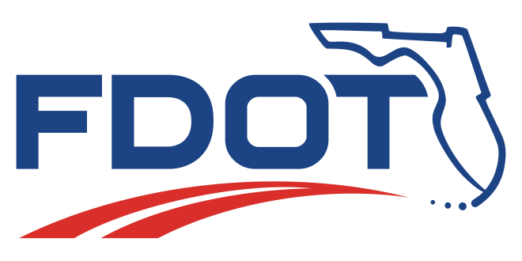
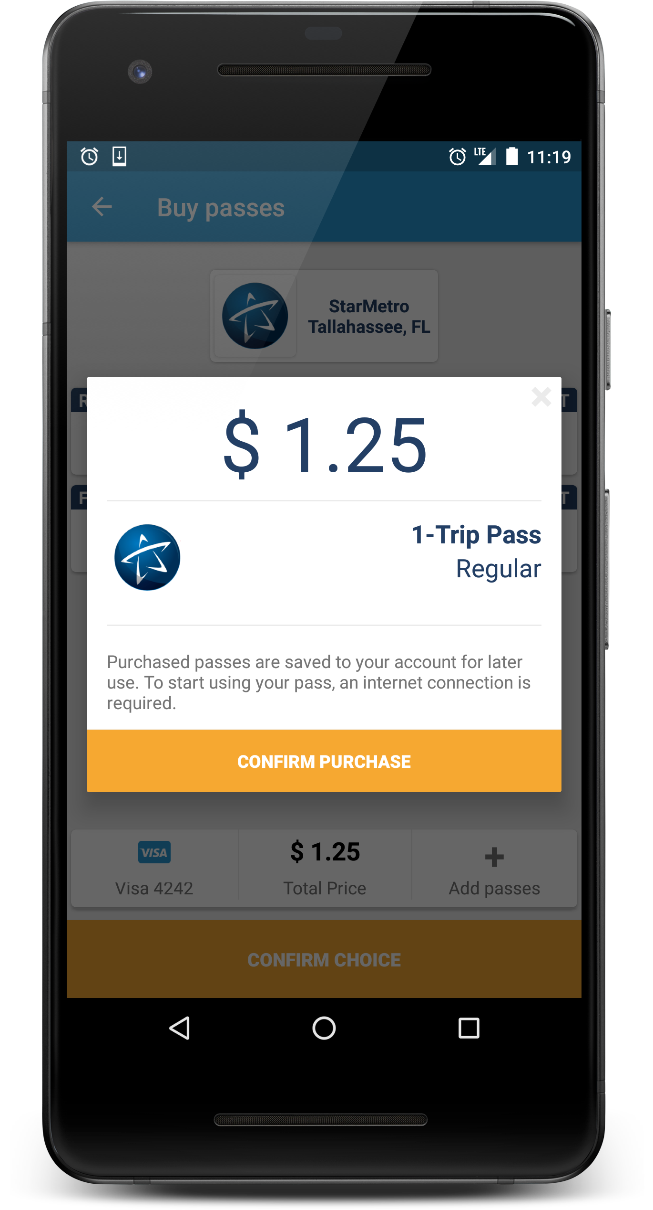
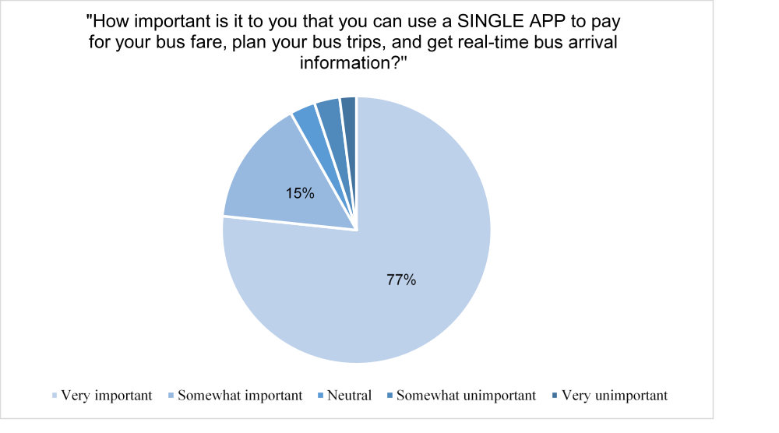
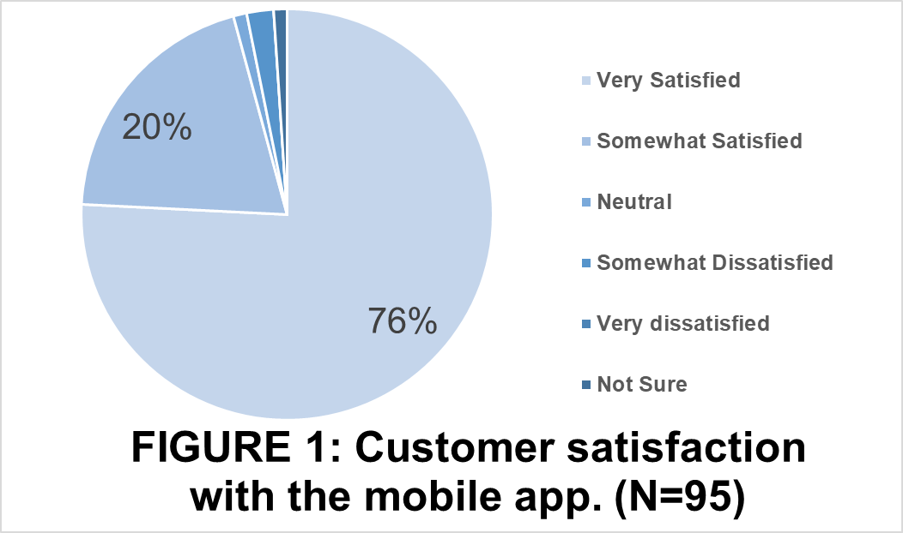

Transit Customer Satisfaction with Mobile Fare Payment (Paper No. 19-03329)
Acknowledgements
For full report, please contact Hendricks@cutr.usf.edu
Sara J. Hendricks, AICP, Senior Research Associate ‣ Center for Urban Transportation Research, University of South Florida
Candace Brakewood, Ph.D., Assistant Professor of Civil and Environmental Engineering, University of Tennessee - Knoxville
Sean Barbeau, Ph.D., Principal Mobile Software Architect for R & D, Center for Urban Transportation Research, University of South Florida
Ann Joslin, TMI Senior Research Associate, Center for Urban Transportation Research, University of South Florida
The researchers wish to acknowledge the
Florida Department of Transportation, Transit
Office for its sponsorship of this research, under the guidance of Kyle Masters, Project Manager; and Gabrielle Matthews, Transit Planning Administrator.
Abstract
Findings
TABLE 1:
Why Customers were Satisfied Using Mobile Fare Payment
TABLE 2:
Why Customers were Not Satisfied Using Mobile Fare Payment
The baseline pre-test survey of the bus riders included questions about the characteristics of their existing bus pass purchases and demographics questions. Sixty-eight percent (N=375) paid by cash.
The post-test survey contained several questions relating to the level of bus rider satisfaction with the app. For those who participated in the pilot and completed the post-test survey, Figure 1 illustrates satisfaction levels.
The survey asked participants to explain why they were or were not satisfied with the mobile fare payment app. The responses are paraphrased and summarized below in Tables 1 and 2, listed by the most frequent response first, to the least frequent response.
The most common negative feedback was difficulty activating passes because of Internet connectivity issues when getting ready to board the transit vehicle (Table 2). StarMetro uses a Wi-Fi “captive portal” that requires users to agree to Terms of Service prior to allowing the device to access the Internet. The research team hypothesizes that when a bus arrives, the rider’s phone (depending on device settings and prior Wi-Fi hotspot use) may try to automatically connect to the bus Wi-Fi. However, because the user had not yet opened their Internet browser and agreed to the Terms of Service, all data connectivity to the Internet was blocked. As a result, when the user tries to activate their ticket, their device cannot communicate with the vendor’s servers and the user gets an error message or is simply stuck waiting for a response. Possible solutions are for users to turn off Wi-Fi on their device, or StarMetro can re-configure their Wi-Fi hotspots to avoid blocking data.
Users also expressed a strong preference for using a single app to pay fares, plan trips, access real-time information, etc. (Figure 2).
Since 2012, public transit agencies in the United States have been using mobile technologies to provide fare payment options to riders (1). Mobile apps can potentially reduce the cost of infrastructure replacement, increase customer satisfaction, and reduce the cost of fare collection (2). A pilot of a mobile fare payment app was conducted at the StarMetro public transit agency in Tallahassee, FL, in which pilot participants identified benefits and challenges of using the mobile fare payment app. The mobile app by the vendor, Token Transit, was used.
Frequency of Comment | Comment
20 | Convenient
19 | Easy to use
6 | Do not have to carry cash
4 | Will not lose bus pass on your phone
3 | Saves time
3 | Do not have to travel to buy bus passes
2 | Reliable
Frequency of Comment | Comment
6 | Slow Wi-Fi, slow to activate purchased pass
5 | Wish to be able to use mobile app offline
2 | Worry about dead phone battery
2 | Did not know what to show the driver
1 | Thinks there is no capability to purchase pass for another rider
1 | Apple Pay, Android Pay, Touch ID not enabled
Methodology
Mobile app configuration allowed purchase of all StarMetro fixed route bus fare options by customers using both Android and iOS devices.
Financial integration was arranged between the vendor’s third party payment processor and StarMetro.
The app was compliant with Payment Card Industry (PCI) standards and with accessibility best practices, supporting use of VoiceOver for iOS and TalkBack for Android devices.
To prevent fraud, the app provided unique and daily changing phone screen graphics and animation.
An internal beta test included focus groups with transit customers and agency testers boarding buses with their electronic passes to provide bus operators the opportunity to practice visually validating the electronic passes. App functionality feedback was relayed to the app developer.
A public field test of the app, from September 2017 through March, 2018, by volunteer bus riders who qualified to participate was conducted. Qualifications included being age 18 or over, having access to a Smartphone, and not attending a local university that provides free StarMetro transit rides by presenting a student ID.
There were a total of 381 responses to a pre-test survey, administered fall 2017, with a total of 360 bus riders who successfully completed the baseline pre-test survey to gain entry into the pilot. Approximately eight weeks later, a post-test survey was administered. A total of 106 participants completed the post-test survey.
Conclusions
The availability of APIs, deep links, and SDKs will provide the agency with more flexibility and integration options when they decide to pursue a single app that includes easy access to multiple transit features (via either partial or full integration).
This requirement for open access could also extend to other multimodal solutions deployed in the region. For example, if bikeshare is being deployed in the area, the bikeshare vendor and operator should be required to provide a General Bikeshare Feed Specification (3).
If a de facto or official standard exists for a particular integration area (e.g., GBFS for bikeshare), the vendor should be required to implement that standard.
Overall levels of satisfaction with mobile payments are high. Despite the high levels of satisfaction, some minor challenges associated with mobile fare payments were also identified.
The ease of purchasing StarMetro bus passes using the mobile fare payment app is incumbent upon the bus rider’s smartphone capabilities, such as battery life, Wi-Fi availability, and an available cellular data plan.
Riders encountered occasional problems when activating passes using on-board bus Wi-Fi, which may be due to Wi-Fi “captive portals” that force users to visit a web page before connecting to the Internet. Riders can avoid this issue by using a cellular data connection instead of Wi-Fi. However, lower income households that use Wi-Fi to conserve limited cellular data plans (which are less expensive than unlimited data plans) may encounter this problem more frequently. StarMetro could also re-configure their Wi-Fi to avoid blocking data traffic when users re-connect to Wi-Fi.
Survey results also indicate that riders want to be able to easily access real-time information, trip plans, fare payment, and other features within a single app, as opposed to having separate apps for each feature that are not linked to each other.
Partial integration, where a single app serves as the “master” app and links to the other app features as needed, can be accomplished using deep links and Application Programming Interfaces (APIs). Full integration using APIs and/or SDKs typically requires higher integration and maintenance costs but provides the agency with more complete control over the user interface and branding of all of the various functionality. To help support either integration option, agencies are encouraged to require that vendors responding to Requests for Proposals (RFPs) include open APIs, deep links and/or SDKs in their solutions.
FIGURE 2. Importance of using a single app to plan for travel. (N=86)
Brakewood, C. Assessing NJ TRANSIT’s Mobile App for Users’ Receptiveness to Geotargeting. University Transportation Research Center, City College of New York. New York, NY. 2015.
Anders, J., C. Brakewood, and K. Watkins. A Case Study Analysis of New Fare Payment Systems in Public Transit. Presented at 93rd Annual Meeting of the Transportation Research Board, Washington, D.C., 2014.
General Bikeshare Feed Specification (GBFS) - https://github.com/NABSA/gbfs.

